Slide 1
Chapter Quality Network Where are we headed on this ADHD Quality Journey?
Chapter Quality Network ADHD Project
Suzanne Emmer, Director, Division of Chapter QI Initiatives
Joseph J. Abularrage, MD, MPH, M.Phil, FAAP, President, NYS AAP - Chapter 2

Slide 2
Commercial Interests Disclosure
Suzanne Emmer
Joseph J. Abularrage, MD, MPH, M.Phil, FAAP
I have no relevant financial relationships with the manufacturer(s) of any commercial product(s) and/or provider of commercial services discussed in this CME activity.
I do not intend to discuss an unapproved or investigative use of a commercial product/device in my presentation.

Slide 3
Session Objectives
Review how CQN ADHD aligns with other chapter activities
Understand how national, chapters and practices will work together to implement the project
Outline goals and vision of the CQN ADHD project

Slide 4
NYS AAP - Chapter 2 & QI
Chapter 2 has been exploring multiple avenues to assist members in enhancing their practice skills
Many of our members have been trained in the CAP PC program which provides high level skills to pediatricians who want to treat and do medication management of low to medium level child mental health issues in the primary care setting
Many members have used the CAP PC hot line to get specific information about a specific child’s issues
Other members have used the CAP PC Resource service to learn what kinds of children’s mental health and family services are available to children and families in their communities.

Slide 5
Today as we launch our ADHD QI project, I am pleased to introduce two important partners in the work that we do for children and families struggling with mental health challenges:
Dr. Victor Fornari is a child psychiatrist at Northwell, formerly LIJ/North Shore, and a core trainer for CAP PC.
Leslie Cummins, LCSW, is the community resources liaison for CAP PC. She is the person who will help you find appropriate resources for your ADHD children and families.

Slide 6
CAP PC Phone # & Website
Here is help when you need it to better care for your children and families with mental health challenges:
CAP PC Hotline 855-227-7272
CAP PC Website www.cappcny.org

Slide 7
Starting our improvement journey – together.

Slide 8
Quality
Every child gets the right care, every time.

Slide 9
Health Care Delivery Transformation
Team-Based Care
Family Engagement
Performance Data
Up-to-Date Science
Population Health
Community Connections

Slide 10
Change is hard.

Slide 11
Why is change so hard?

Slide 12
Why ADHD?
Notes:
5-10% of kids have ADHD
Educational Outcomes:
Summary: children with combined ADHD (hyperactive and inattentive) are more likely to drop out of high school and young adults with ADHD are less likely to enroll in college.
32.2% of students with the combined type of ADHD (hyperactive and inattentive) drop out of high school, compared to 15% of teens with no psychiatric disorder (Breslau et al. 2011).
Kuriyan et al (2013) on college educational outcomes for young adults with ADHD:
They are 11 times more likely to not enroll in any school vs. enrolling in a 4-year college.
50% attend vocational or junior colleges vs. 18% of the non-ADHD comparison group.
15% hold a 4-year degree compared to 48% of the non-ADHD control group.
0.06% held a graduate degree compared to 5.4% of the non-ADHD control group.
Occupational Outcomes:
Summary: young adults with ADHD are more likely to be unemployed, more likely to have been fired or laid off, more likely to quit a job due to dislike and they earn less money.
Kuriyan et al (2013) on occupational outcomes for young adults with ADHD:
They are 11 times more likely to be unemployed and not in school.
They are 4 times more likely to be in unskilled vs. clerical occupation, and 6 times more likely to be in unskilled vs. professional occupations.
61% more likely to have ever been fired, compared to 43% of the non-ADHD comparison group.
33% more likely to have ever been laid off, compared to 13% of the non-ADHD comparison group.
53% more likely to have ever quit a job due to dislike, compared to 36% of the non-ADHD comparison group.
They earned close to $2 per hour less in wages than the non-ADHD comparison group.
Social Outcomes:
Summary: children with ADHD are 3 times more likely to have peer problems and 10 times more likely to have difficulties that interfere with friendships.
Parents of children with a history of ADHD report that their children have almost 3 times as many peer problems as those without a history of ADHD (21.1% vs. 7.3%) (Strine et al. 2006).
Parents report that children with a history of ADHD are almost 10 times as likely to have difficulties that interfere with friendships (20.6% vs. 2.0%) (Strine et al. 2006).
Injury Outcomes:
Summary: children and young adults with ADHD are more likely to be injured.
A higher percentage of parents of children with attention-deficit/hyperactivity disorder reported non-fatal injuries (4.5% vs. 2.5% for healthy children). (Xiang et al. 2005)
Children with ADHD, compared to children without ADHD, were more likely to have major injuries (59% vs. 49%), hospital inpatient (26% vs. 18%), hospital outpatient (41% vs. 33%), or emergency department admission (81% vs. 74%). (Leibson et al. 2001)
Data from international samples suggest that young people with high levels of attentional difficulties are at greater risk of involvement in a motor vehicle crash, drinking and driving, and traffic violations. (Woodward et al.)
Lots of room for improvement in the outcomes and we can start by improving how we deliver care.
High prevalence means…
We can assess changes in our processes quickly
We can help a high number of patients by improving our processes for ADHD care
References:
Breslau, Joshua et al. (March 2011). Childhood and adolescent onset psychiatric disorders, substance use, and failure to graduate high school on time. Journal of Psychiatric Research 45(3):295–301.
Kuriyan, Aparajita B. et al. (January 2013). Young Adult Educational and Vocational Outcomes of Children Diagnosed with ADHD. Journal of Abnormal Child Psychology 41(1):27–41.
Strine TW et al. (March 2006). Emotional and behavioral difficulties and impairments in everyday functioning among children with a history of attention-deficit/hyperactivity disorder. Preventing Chronic Disease 3(2):A52.
Xiang H et al. (November 2005). Nonfatal injuries among US children with disabling conditions. American Journal of Public Health 95(11):1970-5.
Leibson CL et al. (January 2001). Use and costs of medical care for children and adolescents with and without attention-deficit/hyperactivity disorder. JAMA 285(1):60-6.
Woodward et al. (May 2000). Driving outcomes of young people with attentional difficulties in adolescence. Journal of the American Academy of Child and Adolescent Psychiatry 39(5):627-34.
References found on:
CHADD’s website: http://www.chadd.org/Understanding-ADHD/About-ADHD/Data-and-Statistics/Long-Term-Outcomes.aspx
CDC website: http://www.cdc.gov/ncbddd/adhd/data.html

Slide 13
Parent and Teacher Vanderbilt Assessments Used at Diagnosis
90%
90%
90%
56.7%
55.5%
56%
Source: Epstein JN, Kelleher KJ, Baum R, et al. Variability in ADHD Care in Community-Based Pediatrics. Pediatrics. 2014;134:1136-1143.
Notes:
Current State: in one study (data is from Jeff Epstein’s variability in ADHD care study) in Ohio in which they reviewed charts from pediatricians over the past year, 56.7% of patients had a parent assessment included at diagnosis. 55.5% of patients had a teacher assessment included at diagnosis. Ages of patients are not recorded in the study; they selected a sample of pediatricians that treated “mostly children.”
Goal: our project goal is for at least 90% of all patients assessed for ADHD to have a parent and a teacher assessment returned within 30 days of assessment initiation. So, note that our measure is a composite measure of both parent and teacher assessments. So for this reason, and because we want it to be within 30 days, our measure is a little tougher than just having 90% of assessment patients have parent and teacher assessments included at diagnosis.
Source: Epstein JN, Kelleher KJ, Baum R, et al. Variability in ADHD Care in Community-Based Pediatrics. Pediatrics. 2014;134:1136-1143.

Slide 14
Guideline-Based Treatment: Medication and Behavioral Treatment (for children ages 6+)
80%
30%
Source: http://www.cdc.gov/ncbddd/adhd/play2.html. PLAY Study Findings (Project to Learn About ADHD in Youth)
Notes:
Current State: Visser et al. found that less than 1 in 3 children with ADHD received both medication treatment and behavioral therapy, the preferred treatment approach for children ages 6 and older.
Goal: in this project, our goal is to increase the percentage of children who are diagnosed with ADHD and prescribed behavior therapy to 80%. We realize that most children will be on ADHD medication (the same study by Visser et al. found that 70.4% of diagnosed children had received medication treatment within the past week;’ Epstein et al. found that 93.4% of diagnosed children were prescribed medication). So, this isn’t an apples to apples comparison, but it does show that we have a long way to go.
Source: Visser, S. N., Bitsko, R. H., Danielson, M. L., Gandhour, R., Blumberg, S. J., Schieve, L., Holbrook, J., Wolraich, M., Cuffe, S. (2015). Treatment of attention-deficit/hyperactivity disorder among children with special health care needs. Journal of Pediatrics, published online April 1, 2015.
http://www.cdc.gov/ncbddd/adhd/data.html.

Slide 15
Patients Prescribed Behavioral Treatment (ages 4-17)
80%
44%
Source: http://www.cdc.gov/ncbddd/adhd/play2.html. PLAY Study Findings (Project to Learn About ADHD in Youth)
Notes:
Current State: only 44% of children in a 2009-2010 survey had received behavioral therapy in the past year (amongst children with special health care needs ages 4-17)
Goal: in this project, our goal is to increase the percentage of children who are diagnosed with ADHD and prescribed behavior therapy to 80% (where behavior therapy is available).
Source: Visser, S. N., Bitsko, R. H., Danielson, M. L., Gandhour, R., Blumberg, S. J., Schieve, L., Holbrook, J., Wolraich, M., Cuffe, S. (2015). Treatment of attention-deficit/hyperactivity disorder among children with special health care needs. Journal of Pediatrics, published online April 1, 2015.
http://www.cdc.gov/ncbddd/adhd/data.html.

Slide 16
Preschool-Aged Patients Prescribed Behavioral Treatment
80%
47%
Source: http://www.cdc.gov/ncbddd/adhd/play2.html. PLAY Study Findings (Project to Learn About ADHD in Youth)
Notes:
Current State: Visser et al. found that among preschool-aged CSHCN with ADHD, 25.4% received medication treatment alone, 31.9% received behavioral therapy alone, 21.2% received both treatments, and 21.4% received neither treatment. This means about 47% of preschool-aged children with ADHD did not receive any behavioral treatment, which is the recommended first-line treatment for this age group.
Goal: in this project, our goal is to increase the percentage of all children who are diagnosed with ADHD and prescribed behavior therapy to 80% (where behavior therapy is available). We do not call out the preschool age group in our measures.
We may want to note that access to behavioral treatment is an issue and that chapters are working to find resources for the practices.
Source: Visser, S. N., Bitsko, R. H., Danielson, M. L., Gandhour, R., Blumberg, S. J., Schieve, L., Holbrook, J., Wolraich, M., Cuffe, S. (2015). Treatment of attention-deficit/hyperactivity disorder among children with special health care needs. Journal of Pediatrics, published online April 1, 2015.
http://www.cdc.gov/ncbddd/adhd/data.html.

Slide 17
Patients who receive follow-up within 30 days of medication initiation
60%
40%
Source: NCQA State of Health Care Quality Report: http://dnnstage.ncqa.org/ReportCards/HealthPlans/StateofHealthCareQuality/2014TableofContents/ADHD.aspx
Notes:
Current State: according to the NCQA State of Health Care Quality Report, only about 40% of patients receive follow-up care within 30 days of initiation of their first ADHD prescription.
Goal: our project measure is pushing practices to achieve an increase to 60% of patients receiving follow-up care within 30 days of medication initiation.
Overall, these data suggest that there is some urgency to improving the quality of ADHD care.
Source: NCQA State of Health Care Quality Report: http://dnnstage.ncqa.org/ReportCards/HealthPlans/StateofHealthCareQuality/2014TableofContents/ADHD.aspx

Slide 18
That’s where CQN comes in.
Notes:
Overall, these data suggest that this is some urgency to improving the quality of ADHD care.
Note that quality is the central pillar of the AAP agenda for children. CQN helps to achieve that mission.

Slide 19
CQN Works at Three Levels
National
Execute large-scale quality improvement projects
Chapter
Build capacity to engage in QI work with practices and develop state partners
Practice
Improve care practices and child health outcomes
Notes:
National will provide measures, data collection via the mehealth portal, QI coaching and advising, supplemental faculty for learning sessions, supporting project management, CME and MOC.
Chapters provide local leadership and project management, faculty and facilities for Learning Sessions 1 and 3, practice level coaching through monthly practice calls, and attendance and collaboration on chapter calls.
Practices provide practice level leadership, teams that are engaged in the QI process, commitment to regular data collection and transparent data sharing among staff, and attendance at calls and learning sessions.

Slide 20
AIM:
To build a sustainable quality improvement infrastructure within our practice to achieve measureable improvements in ADHD care processes.
Notes:
So that brings us to the broad global aim for your teams: to build a sustainable QI infrastructure within your practices to achieve measureable improvements in ADHD care processes. So that’s the broad aim for our project, but we have a number of more specific goals within that aim…

Slide 21
Goals for Practices by November 2016
90% of patients assessed for ADHD will receive Vanderbilt assessments from the parent and teacher within 30 days of assessment initiation
Physicians have an initial conversation with parents about ADHD and give an educational booklet to 90% of parents/patients diagnosed with ADHD
60% of patients who are prescribed medication will receive follow-up Vanderbilt assessments from the parent and teacher within 30 days of medication initiation
80% of patients diagnosed with ADHD are prescribed behavioral treatment (where behavioral treatment is available)
Notes:
We will be measuring your practice’s performance on many measures throughout this project, but these are the four we are going to emphasize the most throughout the project:
Helping your practice get Vanderbilt assessments back from parents and teachers within 30 days of ADHD assessment initiation
The goal for this measure is to have 90% of your patients who are assessed for ADHD receive both a parent and teacher assessment back within 30 days.
Helping you and your colleagues have more thorough, documented, initial conversations with parents about their child’s ADHD diagnosis and give them an ADHD educational booklet
Goal is to do this with at least 90% of parents/patients diagnosed with ADHD
Helping your practice get follow-up Vanderbilts back from parents and teachers within 30 days of medication initiation.
Goal is to receive follow-up Vanderbilt assessments from the parent and teacher within 30 days of medication initiation with at least 60% of your patients who are prescribed medication
Helping your practice find resources so you can prescribe behavior therapy (where available)
Goal is to prescribe behavior therapy to 80% of patients diagnosed with ADHD (where behavior therapy is available)

Slide 22
But how are we going to do that?

Slide 23
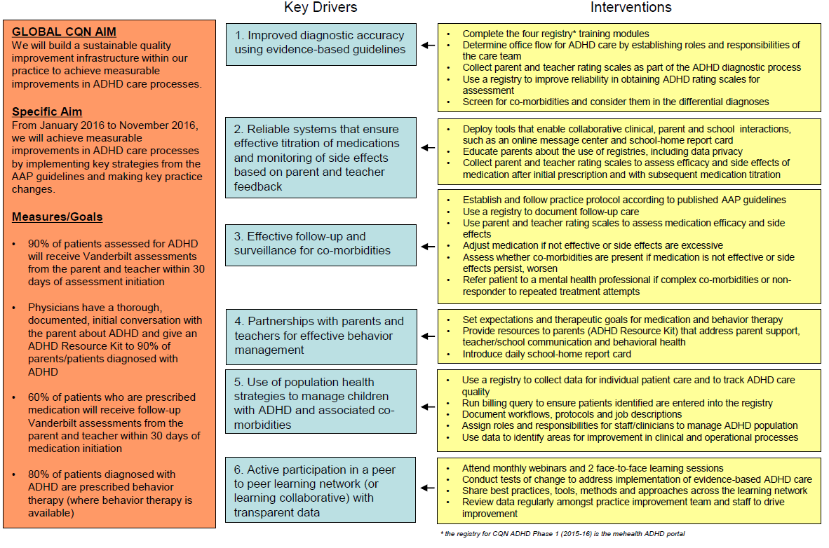
Practice Key Driver Diagram
6 Key Drivers
1. Improved diagnostic accuracy using evidence-based guidelines
2. Reliable systems that ensure titration of medications and monitoring of side effects based on parent and teacher feedback
3. Effective follow-up and surveillance for co-morbidities
4. Partnerships with parents and teachers for effective behavior management
5. Use of population health strategies to manage children with ADHD and associated co-morbidities
6. Active participation in a peer-to-peer learning network (or learning collaborative) with transparent data
Notes:
This is the practice key driver diagram that you saw in pre-work. It explains our project on one page. It captures our global and specific aims, as well as how we’ll measure achievement of those aims.
The center of the diagram is the 6 “key drivers” that will drive achievement of our aims – these are the 6 driving forces that evidence shows improve ADHD care and outcomes. So, these key drivers are the 6 BROAD things we will be working on with practices – in small pieces at a time – to improve throughout the collaborative.
The specific things you will do to implement these key drivers in your practice are the interventions on the right side of the diagram. As you can see, the interventions are categorized by key driver.
We understand this is a lot to process, and we do not want to overwhelm you. As I mentioned, we will be tackling this in SMALL PIECES. In the first action period (the time between LS1 and LS2), we will be focusing on key drivers 1,2 and 3.

Slide 24
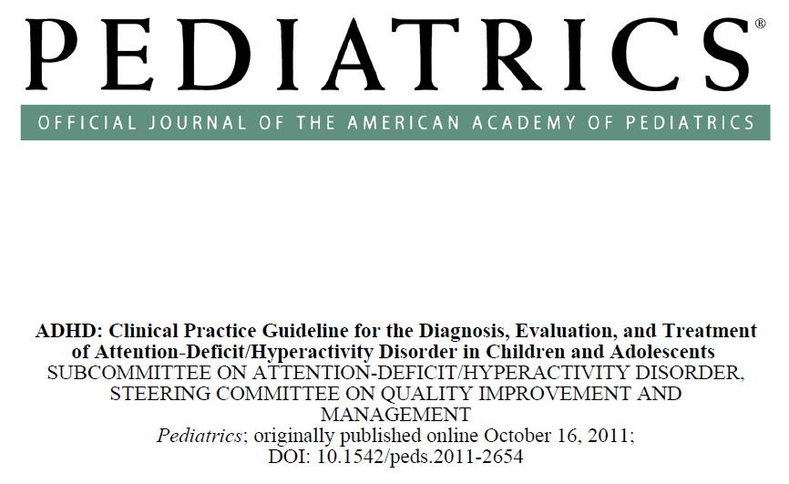
Focus: Practice Key Driver 1
Improved diagnostic accuracy using evidence-based guidelines.
Notes:
First, we will work on key driver #1: improving our diagnostic accuracy using evidence-based guidelines. This means using the DSM-5 criteria to diagnose patients and also documenting impairment in more than one major setting; i.e., get parent and teacher Vanderbilts back more often and in a more timely fashion.
The mehealth portal, which you were exposed to in pre-work, will help you with this quite a bit, and we’ll be working with you today and in the coming months to integrate the portal into your practice workflows.

Slide 25
Focus: Practice Key Driver 2
Reliable systems that ensure titration of medications and monitoring of side effects based on parent and teacher feedback
Notes:
We will also be focusing on key driver 2 through our emphasis on creating reliable systems in your practices. Initially, we will focus more on creating reliable systems for assessment and diagnosis, but as we move further into the project, we will also begin to focus on reliable systems for medication titration and monitoring of side effects.
What do we mean by reliable systems? We mean standardizing your practice’s care delivery processes, much like an airline standardizes its processes so customers receive consistent and comparable levels of service. Think about it: your experience on different airline flights – even across carriers – is usually pretty similar, right? You know what to expect each time you arrive at the airport. We don’t usually see this in medicine, and while the airline industry and medicine are obviously quite different, we can learn something from how the airline industry has managed to develop systems that provide similar levels of service across companies and individuals, and we can try to replicate that, to an extent, in our practice.

Slide 26
Focus: Practice Key Driver 3
Effective follow-up and surveillance for co-morbidities.
Notes:
The final key driver that we will be focusing on during action period 1 is key driver #3: effective follow-up with patients and surveillance for co-morbidities. This means documenting follow-up care (and doing it in a timely fashion) and continuously assessing for co-morbidities, particularly if medication is not effective or side effects persist or worsen. It also means referring your patients to a mental health professional if the patient has complex comorbidities or if they are not responding to treatment.
We will be helping you adjust how you deliver care to improve in this area, and the mehealth portal will be a great help, particularly with follow-up, as it can automate follow-up Vanderbilts.

Slide 27
The First Step...
Today we’ll build your team’s foundational knowledge that is needed to improve how you deliver ADHD care.
Review the AAP ADHD guidelines
Hear the parent perspective on ADHD
Demonstrate how to use the mehealth portal
Discuss how we’ll measure success
Review QI basics that will help create a reliable system for ADHD care in your practice
Notes:
These changes won’t happen overnight. Today is the first step on our journey towards improved ADHD care, and we’ll be arming you with the baseline knowledge you’ll need to be successful in this collaborative and successful in improving how you deliver ADHD care.
Today we will:
Review the AAP ADHD guidelines and demonstrate how this entire project is centered around these guidelines – this did not come out of nowhere!
Hear the parent perspective on ADHD so we have that perspective at the forefront of our minds and are better prepared to provide family-centered care.
Demonstrate how to use the mehealth portal, which ties into how we’ll measure success in this project
And, we’ll review QI basics that will help create a reliable system for ADHD care in your practice. Part of this is learning how to create and test small changes in how you deliver care, which we’ll practice today.
This will give you a strong foundation for the rest of the project and kick start your team’s learning and change efforts.

Slide 28
Let’s get started!

