Slide 1
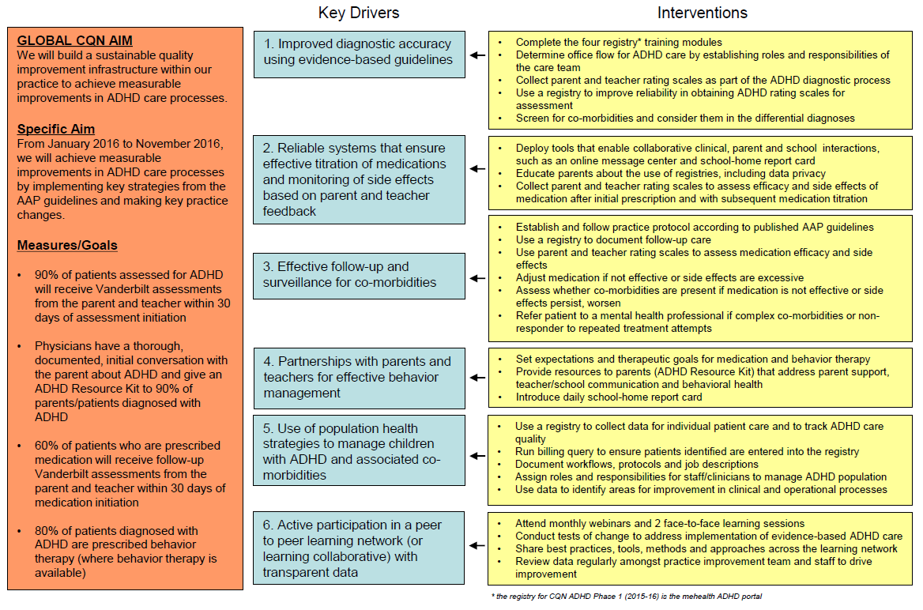
Practice Key Driver Diagram

Slide 2
The Parent Perspective
Chapter Quality Network ADHD Project
Jen Powell, MPH, MBA, Quality Improvement Consultant
Emily Diamond, Parent Advisor

Slide 3
Commercial Interests Disclosure
Jennifer Powell, MPH, MBA
Emily Diamond
I have no relevant financial relationships with the manufacturer(s) of any commercial product(s) and/or provider of commercial services discussed in this CME activity.
I do not intend to discuss an unapproved or investigative use of a commercial product/device in my presentation.

Slide 4
Session Objective
Understand the perspective of a parent of a child with ADHD

Slide 5
Share your story as a parent of children with ADHD.

Slide 6
What emotions and feelings did you have when you learned about the condition?

Slide 7
What topics would be helpful to discuss with your child’s pediatrician at diagnosis and follow-up visits?

Slide 8
What do you know now that you wish you had known sooner about managing ADHD?

Slide 9
Where did you go for support?
i.e., resources (print and online) and people

Slide 10
ADHD is a chronic childhood condition that requires ongoing treatment and active management, often into adulthood.
“No treatments have been found to cure this disorder, but many treatments exist which can effectively assist with its management.”
- Russell Barkley, PhD
Notes:
Source: http://www.russellbarkley.org/factsheets/adhd-facts.pdf

Slide 11
Parents need training and guidance to learn how to manage ADHD children and prepare them for independence.
“Treatment must be provided over long time periods to assist those with ADHD in the ongoing management of their disorder…Chief among these treatments is the education of the family and school staff about the nature of the disorder and its management”
- Russell Barkley, PhD
Notes:
Source: http://www.russellbarkley.org/factsheets/adhd-facts.pdf

Slide 12
Parent involvement is a critical component to effective ADHD treatment for children.
“Care for kids with ADHD will never improve until parents are well trained and know what good treatment looks like.”
- David Rabiner, PhD, Duke University
Notes:
Source: personal interview with Dr. Rabiner, conducted by Elaine Taylor-Klaus.

