Slide 1
Putting ADHD Guidelines Into Practice Through QI
Chapter Quality Network ADHD Project
Jack Levine, MD, FAAP
Chairman, NYS AAP - Chapter 2 Committee on Developmental-Behavioral Pediatrics/Children with Disabiities

Slide 2
Commercial Interests Disclosure
Jack Levine, MD, FAAP
I have no relevant financial relationships with the manufacturer(s) of any commercial product(s) and/or provider of commercial services discussed in this CME activity.
I do not intend to discuss an unapproved or investigative use of a commercial product/device in my presentation.

Slide 3
Session Objectives
Review AAP ADHD Guidelines
Identify how to incorporate national ADHD guidelines into daily practice

Slide 4
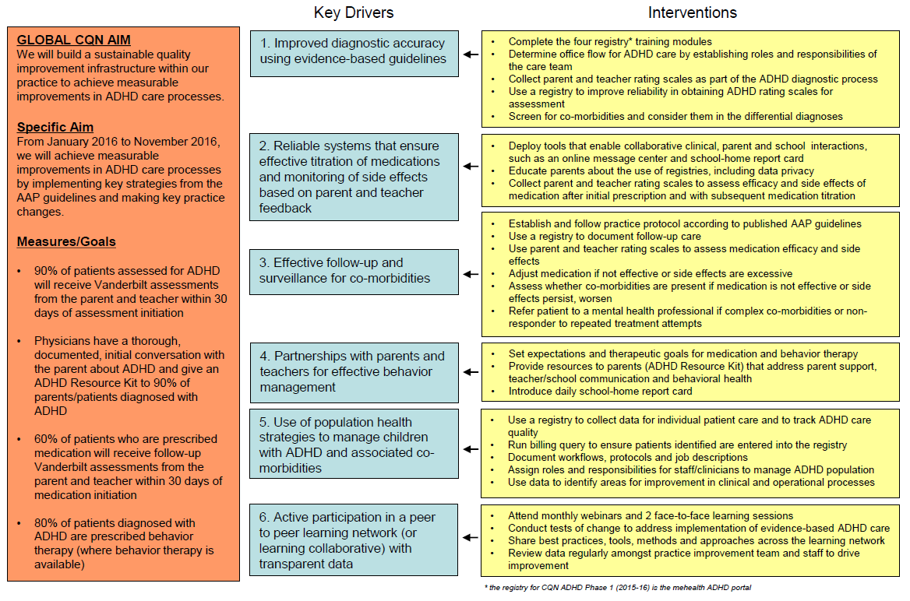
Practice Key Driver Diagram

Slide 5
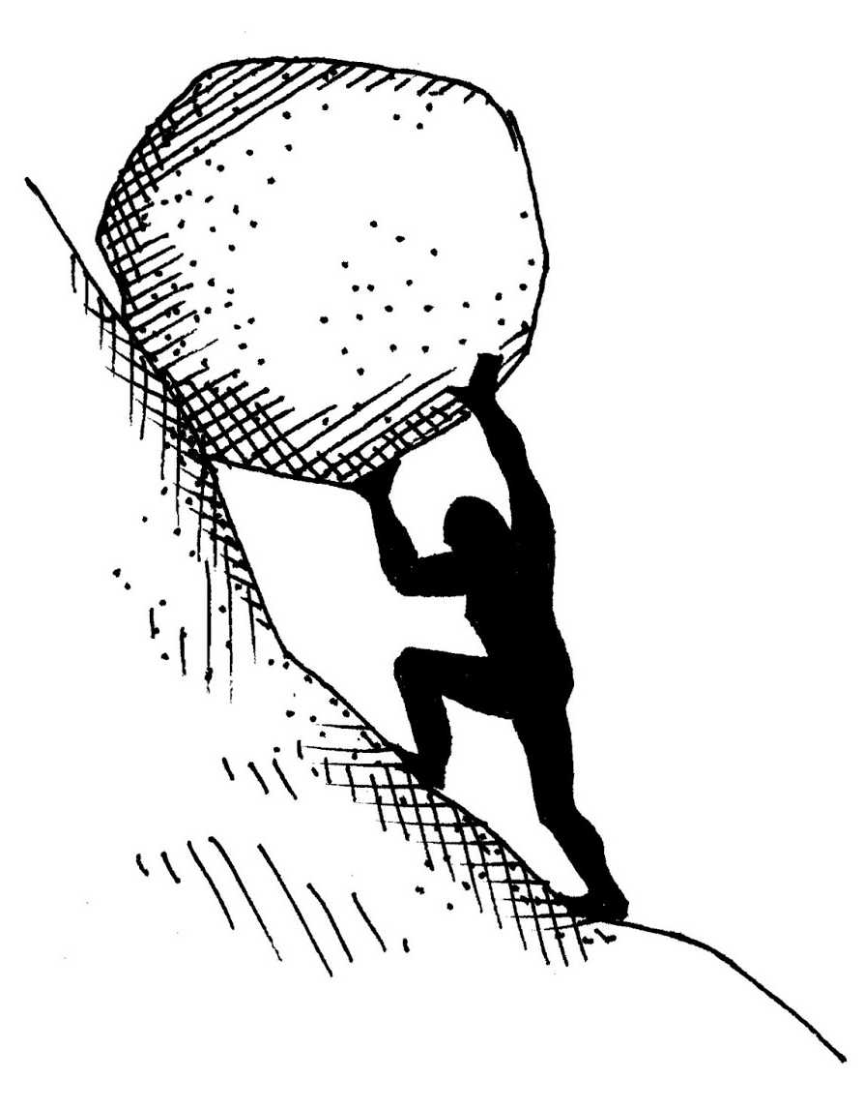
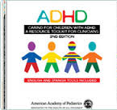
Toward Guideline-Driven Improvement…
CQN projects are built on a model.
And the AAP has already provided us with resources.
Notes:
We are embarking on a QI project, and if you’ve ever done a QI project before, you know that there are going to be challenges ahead and that it won’t always be easy. But, CQN projects are designed to help you out when you don’t know which way to turn, and the AAP wants you to stand on CQN’s shoulders.
CQN projects are built on a model, which includes IHI’s Model for Improvement, and the Academy’s previous experience with QI.
At the beginning, we had consultants from Cincinnati Children’s that helped us get CQN projects off the ground, and now CQN stands on its own. We have been standing on other people’s shoulders.
The Academy also has provided us with the guidelines and the ADHD toolkit, which you’ve received a copy of.
So, we don’t have to reinvent the wheel to do this project. We just have to take the first step.

Slide 6
Our Starting Point
AAP Clinical Practice Guideline for the Diagnosis, Evaluation and Treatment of ADHD in Children and Adolescents
Notes:
And that first step is understanding the AAP’S ADHD the guidelines, which this project is built on. This is what the experts say to do if you want to improve care. They have been vetted extensively and now we’re here to learn how they will inform our QI processes.

Slide 7
Why are you here?
Advantages and Rewards
Provide comprehensive care
Primary care “advantage”
Improve reputation
Attract families
Establish a niche in your office
Expand knowledge
Streamline your approach
Work with other “systems”
Provide optimal care
Mental health interests
Like a good challenge

Slide 8
Barriers and Frustrations
Limited payment for what requires more time:
More time with patients/families
Developing relationships with schools
Coordinating care
Limited access to clinicians for referral
Further assessment may not be available through the education system – payer restrictions, insufficient school resources
Notes:
Insurers don’t want to reimburse pediatricians for “above the neck” issues… they say, “you’re a pediatrician!” I like to remind them that the eyes, ears and throat are above the neck, as well. And kids with mental health issues don’t come in saying that they’re anxious, depressed and inattentive, they come in saying that they have a headache and stomachache, right?
So there’s already limited payment in the pediatric clinic, and the guidelines are going to suggest spending even more time with patients and families.
So, pediatricians think, we can’t do this! So we’ll just refer it out, right?
But there are problems there, too. Quote from guidelines for reference:
“In addition, relegating mental health conditions exclusively to mental health clinicians also is not a viable solution for many clinicians, because in many areas access to mental health clinicians to whom they can refer patients is limited. Access in many areas is also limited to psychologists when further assessment of cognitive issues is required and not available through the education system because of restrictions from third-party payers in paying for the evaluations on the basis of them being educational and not health related.”
Paraphrase of guidelines: Access is limited for assessment of cognitive/learning issues due to non-coverage by insurance and insufficient school system resources.
Yet…insurers won’t pay for education-related diagnosis…but the differential diagnosis between dyslexia and ADHD is a very tough one.

Slide 9
That’s Why We Are Here!!
And the AAP has already provided us with resources.
Notes:
We are embarking on a QI project, and if you’ve ever done a QI project before, you know that there are going to be challenges ahead and that it won’t always be easy. But, CQN projects are designed to help you out when you don’t know which way to turn, and the AAP wants you to stand on CQN’s shoulders.
CQN projects are built on a model, which includes IHI’s Model for Improvement, and the Academy’s previous experience with QI.
At the beginning, we had consultants from Cincinnati Children’s that helped us get CQN projects off the ground, and now CQN stands on its own. We have been standing on other people’s shoulders.
The Academy also has provided us with the guidelines and the ADHD toolkit, which you’ve received a copy of.
So, we don’t have to reinvent the wheel to do this project. We just have to take the first step.

Slide 10
6 Key Action Statements
That sounds doable – right?

Slide 11
Key Action Statement Summary
The primary care clinician should initiate evaluation
Ensure DSM-5 criteria are met
Assess for co-existing conditions
Follow principles of the chronic care model and medical home
Treatment recommendations vary by age
Titrate medication

Slide 12
Assessment Visit
Treatment Visit
Treatment Follow-Up
Long-Term Follow-Up

Slide 13
Key Action Statement 1: Initiate the Evaluation: Primary Care Clinicians should do this!
The primary care clinician should initiate an evaluation for ADHD for any child 4 through 18 years of age who presents with academic or behavioral problems and symptoms of inattention, hyperactivity, or impulsivity (quality of evidence B/strong recommendation).
Notes:
Key action statement 1: The guidelines are very clear that it is primary care clinicians’ job to initiate evaluation.
Quality of evidence grading: see page 5 of the AAP ADHD Guidelines for an explanation.

Slide 14
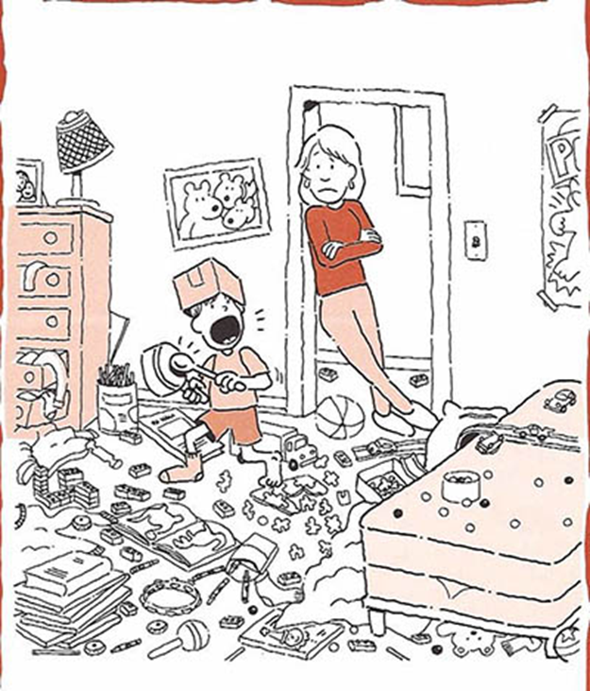
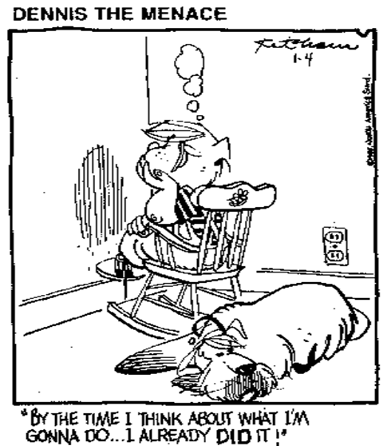
Different Presentations of ADHD

Slide 15
2.5 X More Frequent in Boys than Girls
Females with predominantly inattentive type
Girls are underdiagnosed

Slide 16
Key Action Statement 2: Make the Diagnosis
Determine that DSM-5 criteria have been met (including documentation of impairment in more than 1 major setting).
information should be obtained primarily from reports from parents or guardians, teachers, and other school and mental health clinicians involved in the child’s care.
The primary care clinician should also rule out any alternative cause (quality of evidence B/strong recommendation).
Notes:
Again, in regards to determining that DSM-5 criteria have been met, the guidelines say the primary care clinician should complete this. Primary care pediatricians have a unique advantage in detecting complex co-morbidities (as compared to a specialist or psychologist) because:
They probably know their ongoing patients better than a psychologist can get to know them in one consultation, and
They probably have a better knowledge of whether there is disruption in the home, whether schools in the area are chaotic, past medical issues, family history, etc.
However, many of us delegate this to a specialist when that might not be appropriate.

Slide 17
DSM-5 Criteria For ADHD
6/9 Inattentive and/or 6/9 Hyperactive/Impulsive Symptoms for longer than 6 months & more common than developmentally expected
Symptom onset before age 12
Symptoms occur in more than one setting
Symptoms interfere with or reduce the quality of social, academic or occupational functioning
Symptoms are not better explained by something else
Notes:
5 criteria, A-E
Very important to adhere to these symptoms, need at least 6 of 9
This was one of the few changes from DSM-IV to DSM-5; may help diagnose inattentive children once their ADHD comes out later in life (i.e., middle school)
If it only occurs with math, that’s a math learning disability, not ADHD. If it only occurs at home, that’s more than likely related to a home problem.
A child may still have ADHD if they’re making all A’s and B’s… they may have no friends or be going to bed at 1am because they’re crying from 10-12.
This is why ADHD can be over-diagnosed: because people don’t look for a better reason for it.

Slide 18
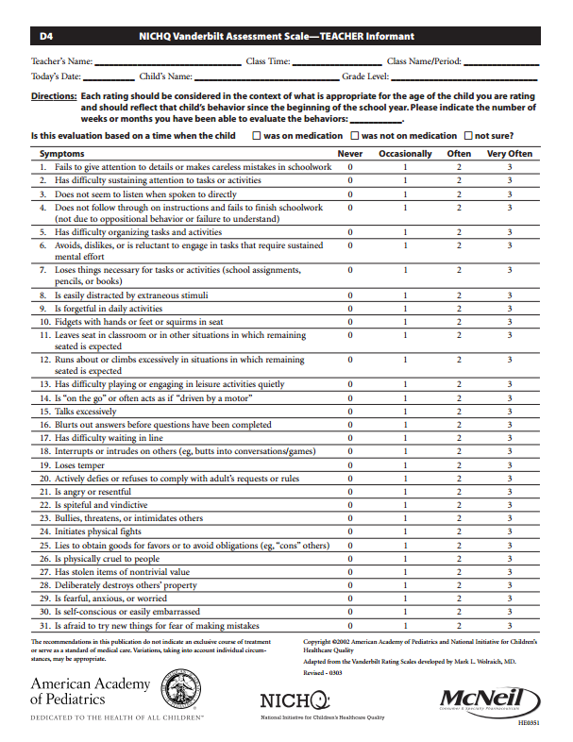
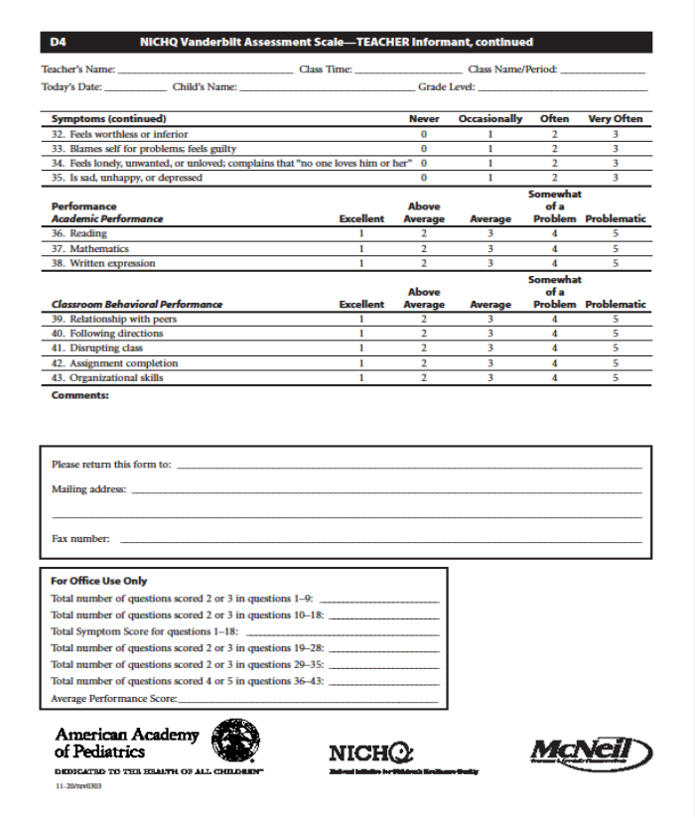
Vanderbilt Assessments
Notes:
Practices will be assessing for ADHD using parent and teacher Vanderbilt scales, which are pictured on the screen.

Slide 19
Vanderbilt ADHD Rating Scales
Parent and teacher forms
The forms assess:
18 ADHD symptoms
Common comorbidities
Oppositional Defiant Disorder
Conduct Disorder
Anxiety
Depression
Areas of Impairment (e.g., school, peer relations)
Pre-existing conditions (e.g., tics, irritability, externalizing symptoms)
To determine child’s baseline levels of common side effects

Slide 20
Differential Diagnosis
Isn’t this what primary care pediatricians do well every day?

Slide 21
Differential Diagnoses (and co-morbidities)
Medical | Psychological | Educational
Sleep disorders Seizures Tourette’s/Tics Thyroid Disorders Traumatic Brain Injury Medication Vision or Hearing Issues | Anxiety/OCD Depression ODD/CD/IED Autism Spectrum Disorder PTSD Other psychiatric disorders | Intellectual Disability LD/Dyslexia Processing Issues Speech/Language Working Memory
Notes:
Sometimes another condition explains the symptoms better than ADHD does; they masquerade as ADHD.

Slide 22
May not be a DSM-5 Diagnosis or Disorder!
Immaturity (younger for grade)
Attentional variation or problem
Gifted
Hyperactive/impulsive variation or problem
Poor classroom environment, under-challenged
Chaotic home environment (e.g., foster care)
Victim of bullying, trauma
Quirky
Temperamental differences
Notes:
But…sometimes the best diagnosis is no diagnosis. One of these things could be true instead.
Immaturity: sometimes this has to do with where they were born in the school year.
80th percentile hyperactivity, impulsivity (“he’s just a boy”)

Slide 23
Key Action Statement 3: Assess Co-Morbid/Co-Occurring Conditions
Assessment for other conditions that might coexist with ADHD:
Mental health/Behavioral
Anxiety, depression, oppositional defiant & conduct disorders
Developmental
Learning and language disorders or other developmental disorders
Physical
Tics, sleep difficulty
(quality of evidence B/strong recommendation)
Notes:
It’s not always that other conditions occur instead of ADHD, sometimes they occur with ADHD. “Squeaky clean” ADHD is rare; most commonly, it’s more than one thing.
On the expert call, the group noted that telling the difference between a differential diagnosis and a co-existing condition is difficult; it is difficult for everyone, but general pediatricians can do it. Sometimes you have to use trial and error to figure out what the problem is.

Slide 24
Assessment Visit
Treatment Visit
Treatment Follow-Up
Long-Term Follow-Up

Slide 25
Key Action Statement 4: Treat ADHD as a Chronic Condition
ADHD is a chronic condition and should see children and adolescents with ADHD as children and youth with special health care needs.
Management of children and youth with special health care needs should follow the principles of the chronic care model and the medical home
(quality of evidence B/strong recommendation).
Notes:
The fourth key action statement is a reminder that treatment of a child with ADHD should be viewed more as long-term management that is patient-centered and fits into the broader resources available in your community. The chronic care model, in particular, is a foundation of CQN projects and will be discussed more today and throughout this collaborative. It is also described in more detail in the pre-work packet you were asked to review before this meeting, as well as the project charter.

Slide 26
Successful Care for CSHCN
Integrated, supportive community
Informed, activated family
Community resources and agencies
FFA
Medical Home
=
Family + MD
Based on Wagner et al.

Slide 27
Key Action Statement 5: Treatment Recommendations Vary by Age
Recommendations for treatment of children and youth with ADHD vary depending on the patient’s age:
Notes:
During treatment, we need to monitor side effects and titrate appropriately, then partner with parents and teachers for effective behavior management. As pediatricians, we do need to emphasize the behavior management more.
Key action statement 5 focuses on treatment and that varies by age…

Slide 28
Preschoolers often present with Hyperactivity
And Inattention
May not have separate observer
Not as many validated assessment tools

Slide 29
Preschoolers: 4-5 Year Olds
For preschool-aged children (4–5 years of age), the primary care clinician should prescribe evidence-based parent- and/or teacher-administered behavior therapy as the first line of treatment (quality of evidence A/strong recommendation)
Notes:
Preschoolers: this is another change from DSM-IV. Previously, they only made recommendations from ages 6-16.
We can diagnose before age 5 now and the proper treatment is evidence-based parent- and/or teacher-administered behavior therapy.
Emphasizes “evidence-based”… oftentimes we refer to someone (because we don’t know what to do) who may be delivering therapies that don’t have an evidence base.
Notice that this evidence is grade A…but how often does it occur in practice?

Slide 30
Behavior Therapy – Behavior Modification
Behavior therapy represents a broad set of specific interventions that have a common goal of modifying the physical and social environment to alter or change behavior. Behavior therapy usually is implemented by training parents in specific techniques that improve their abilities to modify and shape their child’s behavior and to improve the child’s ability to regulate his or her own behavior.
Notes:
Oftentimes parents come in wanting us to fix the kids. But it’s implemented by training the parents. It’s not for the child, it’s for the parents…teach them how to modify the child’s behavior which then improves the child’s ability to regulate their own behavior. A “users guide” for parenting a child with ADHD.
If the child is spending time with a therapist, that is not evidence-based therapy.

Slide 31
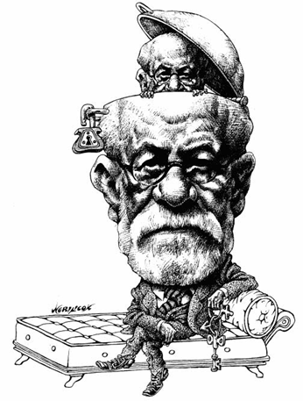
What is NOT Behavior Therapy?
Psychotherapy
Working with the child
Play therapy
Cognitive-Behavioral Therapy
Bio-feedback
Vision training

Slide 32
Finding Behavior Therapy
Resource Guide
Guidelines for Parents and Providers
CAP-PC
Child and Adolescent Psychiatry for Primary Care
http://www.cappcny.org/
1-855-CAPPC72 (227-7272)

Slide 33
Medication in Preschoolers
“...may prescribe methylphenidate if the behavior interventions do not provide significant improvement and there is moderate-to severe continuing disturbance in the child’s function.”
In areas where evidence-based behavioral treatments are not available, the clinician needs to weigh the risks of starting medication at an early age against the harm of delaying diagnosis and treatment (quality of evidence B/recommendation).
Notes:
This guideline recommendation is an off-label use of Ritalin: http://www.fda.gov/downloads/Drugs/DrugSafety/ucm089090.pdf

Slide 34
PATS
Preschool ADHD Treatment Study

Slide 35
PATS
Behavioral interventions were more effective in preschoolers than in school-aged children and adolescents and didn’t cause side effects.
Medication was effective in preschoolers but not as effective as use of medication in school-aged children and with more side effects than medication use in school aged children.
Notes:
Behavioral interventions were more effective in preschoolers than in school-aged children and adolescents and didn’t cause side effects.
Medication was effective but not as effective and with more side effects than medication use in school aged children.

Slide 36
Evidence-Based Behavioral Therapy
Intervention Type | Description | Typical Outcome(s) | Effect Size
Behavioral parent training (BPT) | Behavior-modification principles provided to parents for implementation in home settings | Improved compliance with parental commands; improved parental understanding of behavioral principles; high levels of parental satisfaction with treatment | .55
Behavioral classroom management | Behavior-modification principles provided to teachers for implementation in classroom settings | Improved attention to instruction; improved compliance with classroom rules; decreased disruptive behavior; improved work productivity | .61
Notes:
Found that it is effective and they don’t cause bad outcomes.
Unfortunately, these programs can cost thousands of dollars and are not easily accessible by pediatricians, so there is a reason they’re not being used as recommended.

Slide 37
HHS Agency for Healthcare Research and Quality
Triple P (Positive Parenting Program)
PCIT (Parent-Child Interaction Therapy)
Incredible Years
New Forest Parenting Programme
2011 Report
Notes:
These are some of the evidence-based programs for behavioral therapy. However, they are very expensive.
The CDC does offer a free online module on communication and parenting for parents, so we recommend you direct parents to that resource, as well: http://www.cdc.gov/parents/essentials/communication/
Resource from Kelly on what behavioral therapy should look like: http://effectivechildtherapy.org/content/behavior-therapy-adhd

Slide 38
Elementary School-Aged Children
For elementary school–aged children (6–11 years of age), the primary care clinician should prescribe US Food and Drug Administration–approved medications for ADHD (quality of evidence A/strong recommendation) and/or evidence-based parent and/or teacher-administered behavior therapy as treatment for ADHD, preferably both (quality of evidence B/strong recommendation).
Notes:
For elementary school–aged children (6–11 years of age), the primary care clinician should prescribe US Food and Drug Administration–approved medications for ADHD (quality of evidence A/strong recommendation) and/or evidence-based parent and/or teacher-administered behavior therapy as treatment for ADHD, preferably both (quality of evidence B/strong recommendation).

Slide 39
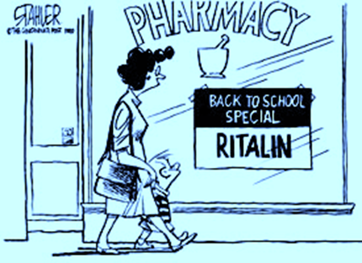
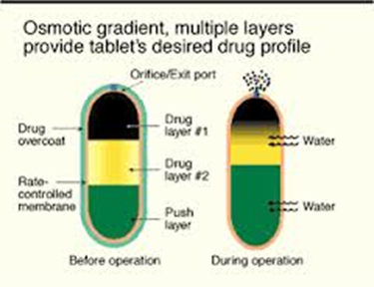
Medication for ADHD
Methylphenidate
d,l-MPH
d-MPH
Amphetamine
Dextroamphetamine
Mixed amphetamine salts – d,l
Lysdexamfetamine
Non-stimulants
Guanfacine
Clonidine
Atomoxetine
Short and Long acting
Delivery system
Combination

Slide 40
Stimulants vs Non-Stimulants and 1 more thing
The evidence is particularly strong for stimulant medications and sufficient but less strong for atomoxetine, extended-release guanfacine, and extended-release clonidine (in that order) (quality of evidence A/strong recommendation).
The school environment, program, or placement is a part of any treatment plan. (No quality of evidence sited)
Notes:
The evidence is particularly strong for stimulant medications and sufficient but less strong for atomoxetine, extended-release guanfacine, and extended-release clonidine (in that order) (quality of evidence A/strong recommendation).
The school environment, program, or placement is a part of any treatment plan. (No quality of evidence sited)

Slide 41
Notes:
Notes from Jeff Epstein:
In MTA study, 579 children with ADHD were randomly assigned to one of 4 treatment strategies (Meds only, Behavioral Tx only, Meds + Behavioral Tx, and Community Control)
For purposes of today’s presentation, only going to focus on two of those groups: Meds Only and Community Control;
Families assigned to community control group were given a list of referrals in the community and told that they could pursue whatever treatment strategy they wanted ON THEIR OWN; 66% of these kids went to community-based providers and received Ritalin – the only medication that was readily available in 1993-1995 when this study was conducted. The other 33% did not pursue meds.
Those who got Ritalin from community [white line] had a greater reduction in ADHD symptoms over the course of 14 months than those who did not pursue medicaiton treatment
But here is the fascinating point – look at the kids who were assigned to the medication only arm of the study – remember these kids received Ritalin in the context of the research study. [green line]
Both sets of children received primarily Ritalin but children who received medication from the study did significantly better. Why?
Those who received in context of study had 1) initial rigorous titration to determine correct dose – 3 different doses tried over the course of the first month of treatment; 2) monthly visits for the first 6 months of treatment – then bimonthly visits; 3) length of follow-up visits was approximately 30 minutes; 4) was contact with teachers on a monthly basis to assess child’s progress in school; 5) use of 3x per day dosing as opposed to typical 2x per day dosing; 6) children treated in context of MTA study were on higher dosages than children treated in community.
These data attest to the fact that the quality of medication treatment affects treatment outcomes of the patients you treat.

Slide 42
Adolescents with ADHD
Procrastination, disorganization, and poor study habits
Academic underachievement, drop out, rule breaking and peer difficulty
Substance abuse, depression, anxiety, risky sexual behavior, teenage pregnancy
Less likely to exhibit overt hyperactive behavior – inattention and impulsivity
Multiple teachers

Slide 43
Adolescents: 12 and Up
For adolescents (12–18 years of age), the primary care clinician should prescribe Food and Drug Administration–approved medications for ADHD with the assent of the adolescent (quality of evidence A/strong recommendation) and may prescribe behavior therapy as treatment for ADHD (quality of evidence C/recommendation), preferably both.
Notes:
For adolescents (12–18 years of age), the primary care clinician should prescribe Food and Drug Administration–approved medications for ADHD with the assent of the adolescent (quality of evidence A/strong recommendation) and may prescribe behavior therapy as treatment for ADHD (quality of evidence C/recommendation), preferably both.

Slide 44
Assessment Visit
Treatment Visit
Treatment Follow-Up
Long-Term Follow-Up

Slide 45
Key Action Statement 6: Dose titration
The primary care clinician should titrate doses of medication for ADHD to achieve maximum benefit with minimum adverse effects (quality of evidence B/strong recommendation).

Slide 46
Dose Titration: Variation in Individual Response
Weight no longer the determining factor
Start low, go (relatively) quickly
End Points: desired response, minimal side effects
Notes:
With respect to the process for titrating stimulants, there is a tremendous amount of variation among patients with respect to how they respond. There are several important organizing principles that you need to keep in mind.
First, contrary to what many of you were probably taught during residency, the patient’s weight is no longer considered to be the basis for determining dose, either a starting dose or a maximum dose. The primary factors appear to be genetic in nature and have to do with how quickly the patient’s liver metabolizes stimulants. Kids are thought to inherit sets of genes, or, more specifically, gene polymorphisms, which determine whether stimulant medications are going to be broken down at a fast, intermediate or slow rate. What this means, in practical terms, is this:
a) If you are a fast metabolizer, you’ll break down the medicine rapidly, and require a higher dose of stimulant to achieve an effective blood level. These, for example, are the 50# kids who end up needing 50 mg of Adderall-XR each day to achieve acceptable symptom control.
b) If you’re a slow metabolizer, the dose will hang around longer, meaning that a small dose of medication will probably be sufficient for achieving an effective blood level. An example of this kind of kid is the 250# kid who only needs 10mg of Adderall-XR to achieve a good response.
c) Most patients, of course, will fall in the middle of the bell-shaped curve. These are the intermediate metabolizers and they can be expected to respond to the usual doses you are comfortable with prescribing.
2)We unfortunately don’t have an easy way yet to test for what kind of metabolizer a given patient is so for the time being, the process for determining what the proper dose is going to be is the old stand-by: trial and error. But, the paradigm here is not the traditional “start low and go slow”. Because the stimulants enter the system quickly, that is within minutes and are gone within hours rather than days or weeks, you can be (and really should be) making titration decisions every 3-7 days. So, in other words, the new paradigm is really “start low and go quickly”.
3)And, finally, you should abandon the concept of maximum dose with respect to the stimulants and think more in terms of stopping titration when you get to one of two clinical end-points: either achieving the desired end-point or encountering undesirable side effects.

Slide 47
Initiating a Stimulant Trial
Weekly titration recommended: relatively quickly
Regular assessment for medication side effects
Frequent input required from teachers and parents
Use Vanderbilt to get objective information
Typically, use follow-up Vanderbilt (focus on ADHD symptoms)
If co-morbidities, use long Vanderbilt (adds ODD/internalizing questions)
Target optimal dose to defined end-points:
25% drop in Total Symptom Score (Vanderbilt)
Nikles et al. Pediatrics; 2006, 117, 2040-2046
Notes:
So, bottom line, what we are recommending is the following:
When you start treatment with a stimulant, the evidence suggests starting with a low dose and titrating weekly or even every 3-5 days. Given that the average child requires 2-3 dose adjustments before he reaches an effective dose, weekly titration should allow you to achieve good symptom control within a month for most kids.
As you titrate, assess for medication side effects on a regular basis. And remember: as long as you’re not seeing any side-effects, you can keep increasing the medication dose until you get a therapeutic response.
In order to conduct an effective rapid titration that monitors closely for side effects, you will need to be getting frequent input from both teachers and parents. Ideally, this means getting follow-up Vanderbilts from both every 1-4 weeks. As our experience with the Collaborative doctors in Cincinnati has taught us, this is not an easy process to manage, particularly when you have to rely on paper forms, fax machines and telephones. In a few minutes, I’m going to show you how the web portal will enable you to substantially simplify communicating with parents and teachers about titration.
You should arrange to see the family one month after starting medication. This is an essential visit for a number of reasons. One, is that it allows you to check weight and blood pressure. Second, it enables you to review with the family what the follow-up Vanderbilts are revealing in terms of symptom reduction at home and school. Third, it gives you an opportunity to find out if the medicine is lasting long enough into the day and if the child is experiencing problems with rebound irritability when the medicine is wearing off. Fourth, it gives you an important chance to engage the your patient directly about how he thinks the medicine is working and whether he remembers what the medicine is supposed to be doing. This is where you begin the whole process of gradually educating your patient to become more knowledgeable about his ADHD and eventually more self-sufficient with managing it. And, finally, the one month office visit has now become a HEDIS measure, which means that insurance companies are beginning to do billing audits to see what percentage of your newly diagnosed patients is being seen for follow-up. Bad news: they’re watching you. The Good news: if you’re doing a good job, this will probably, at some point, translate into enhanced reimbursement for meeting the quality standard.
This is a big concept: you need to be targeting your treatment to a dose that has defined end points. There are three of these. Two of them, the 25% drop in the total symptom score and the normalization in at least one area of impairment, can be measured quantitatively with the Vanderbilt forms. The third is qualitative, and that is acknowledgment by the parents that the goals they’ve identified as being important have been achieved.

Slide 48
Side Effects

Slide 49
Assessment Visit
Treatment Visit
Treatment Follow-Up
Long-Term Follow-Up

Slide 50
Medication Management: Maintenance
Objectives: 1) Maintain symptom reduction
2) Oversee gradual decrease in impairment
3) Monitor for long-term side effects
Once stable, quarterly visits for remainder of school year
Subsequent years: re-assess at least semi-annually, annually
F/U visits should occur 6 – 8 weeks after start of new school year
With all encounters: Obtain teacher and parent rating scales
Encourage/Facilitate obtaining behavioral intervention
Ultimate goal: NO IMPAIRMENTS
Notes:
The objectives of maintenance-focused management are to 1) maintain symptom reduction, 2) oversee the continued gradual decrease in academic, social and behavioral impairment, and 3) to monitor for long-term side-effects.
What the guideline recommends at this stage is that you continue to see the patient and collect Vanderbilt data every three months for the remainder of the current school year. The most important reason for paying relatively close attention is that about 1/3 of patients, once they’ve been stabilized on medication, will experience a “honeymoon” phenomenon, similar to what happens with newly diagnosed diabetics. In other words, once they’ve been stabilized for the first time on a given dose of medication, after 1-2 months, their control begins to erode as evidenced by a gradual increase in the TSS. We’re not sure why this happens yet, but the speculation is that the effected neurotransmitter receptors are either increasing in number or becoming less sensitive in response to being exposed to medication. The result of this process is that this subset of kids will need to have their medication dose increased.
Beyond this, in subsequent years, the patient should be seen either one or two times per year provided his condition remains stable. Ideally one of these visits should occur 6-8 weeks into the new school year, that is, at a time when the child has had a chance to adapt (or, as the case may be, fail to adapt) to the increased demands of the new school year. If he’s having trouble, this affords you an opportunity to adjust his stimulant dose. Regardless of how well the family tells you the kid is doing though, what you’ll want to do at this juncture is obtain Vanderbilts from both parent and teacher so that you can quantitatively assess how the child is doing compared with the previous year. As before, you can get the Vanderbilts filled out on-line.

Slide 51
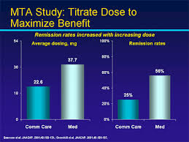

Slide 52
MTA Study
“Because stimulants might produce positive but suboptimal effects at a low dose in some children and youth, titration to maximum doses that control symptoms without adverse effects is recommended instead of titration strictly on a milligram-per-kilogram basis.”
Notes:
Because stimulants might produce positive but suboptimal effects at a low dose in some children and youth, titration to maximum doses that control symptoms without adverse effects is recommended instead of titration strictly on a milligram-per-kilogram basis.

Slide 53
CONCLUSION
“Evidence continues to be fairly clear with regard to the legitimacy of the diagnosis of ADHD and the appropriate diagnostic criteria and procedures required to establish a diagnosis, identify co-occurring conditions, and treat effectively with both behavioral and pharmacologic interventions. However, the steps required to sustain appropriate treatments and achieve successful long-term outcomes still remain a challenge.”

Slide 54
That’s why we’re here!

