Slide 1
The mehealth Portal and CQN ADHD Measurement
Chapter Quality Network ADHD Project
Jeff Epstein, PhD
CQN ADHD National Expert

Slide 2
Commercial Interests Disclosure
Jeff Epstein, PhD
Derived Intellectual Property: ADHD Web Portal Software (www.mehealth.com/adhd)
No other actual or potential conflict of interest in relation to this program / presentation

Slide 3
Session Objectives
Demonstrate clinical utility of mehealth for ADHD web portal
Review ADHD patient flow in the context of the AAP ADHD practice guidelines
Show you how we plan to measure ADHD care for this project

Slide 4
mehealth/ADHD DEMO

Slide 5
CQN ADHD Care Timeline
Assessment Visit
Treatment Visit
Treatment Follow-up
Long-term Follow-up
Use Vanderbilt to assess for ADHD | Have conversation about ADHD diagnosis & provide ADHD brochure
 | Prescribe ADHD medication | Immediately (<2 weeks) assess effectiveness and side effects using ratings | Periodically assess progress using ratings
 | Prescribe Behavior Therapy
Notes:
Patient and family is going to go through these types of visits as they assess and treat appropriately. We have developed measures to assess physicians performance at each stage of this process and will review them with you now.

Slide 6
CQN ADHD Care Timeline
Assessment Visit
Treatment Visit
Treatment Follow-up
Long-term Follow-up
Use Vanderbilt to assess for ADHD | Have conversation about ADHD diagnosis & provide ADHD brochure
 | Prescribe ADHD medication | Immediately (<2 weeks) assess effectiveness and side effects using ratings | Periodically assess progress using ratings
 | Prescribe Behavior Therapy
Notes:
Patient and family is going to go through these types of visits as they assess and treat appropriately

Slide 7
Proper Diagnosis – Action Statement 1
The primary care clinician should initiate an evaluation for ADHD for any child 4 through 18 years of age who presents with academic or behavioral problems and symptoms of inattention, hyperactivity, or impulsivity.
Assessment Visit
Notes:
You know from the guidelines that Jenny should be assessed for ADHD

Slide 8
Proper Diagnosis – Action Statement 2
To make a diagnosis of ADHD, the primary care clinician should determine that Diagnostic and Statistical Manual of Mental Disorders 5, (DSM-V) criteria have been met (including documentation of impairment in more than 1 major setting), and information should be obtained primarily from reports from parents or guardians, teachers, and other school and mental health clinicians involved in the child’s care. The primary care clinician should also rule out any alternative cause.
Assessment Visit
Notes:
You also know from the guidelines that Jenny should be assessed using a validated instrument that assess for the DSM criteria for ADHD across multiple settings

Slide 9
CQN ADHD Assessment Measure 1
% of patients who were assessed for ADHD using a validated instrument (i.e., Vanderbilt Assessment scale) across multiple major settings
Parent-ratings
Teacher-ratings
Goal: 90%
Collection of teacher Vanderbilt assessments increased from approximately 15%-20% at baseline to over 80% in a similar project
Assessment Visit
Notes:
Mehealth will track which patients, including Jenny have had a Vanderbilt completed from the parent and teacher.

Slide 10
Portal Demo
Introduce to Report Card
Scroll down to % with parent and teacher ratings during assessment graph

Slide 11
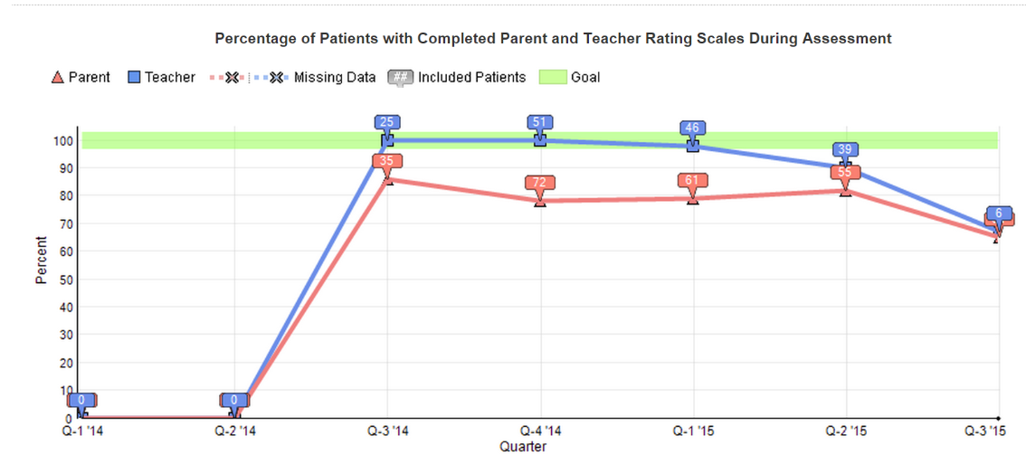

Slide 12
CQN ADHD Care Timeline
Assessment Visit
Treatment Visit
Treatment Follow-up
Long-term Follow-up
Use Vanderbilt to assess for ADHD | Have conversation about ADHD diagnosis & provide ADHD brochure
 | Prescribe ADHD medication | Immediately (<2 weeks) assess effectiveness and side effects using ratings | Periodically assess progress using ratings
 | Prescribe Behavior Therapy
Notes:
Patient and family is going to go through these types of visits as they assess and treat appropriately

Slide 13
Chronic Care – Action Statement 4
The primary care clinician should recognize ADHD as a chronic condition and, therefore, consider children and adolescents with ADHD as children and youth with special health care needs. Management of children and youth with special health care needs should follow the principles of the chronic care model and the medical home.
Treatment Visit
Notes:
Donna is a little upset with the news and wants to know what she can do to help Jenny. Of course, knowing that guidelines indicate that ADHD be treated in accordance with the principles of chronic care model, Medical home and of course a big part of that is parent education and involvement you…

Slide 14
AAP ADHD Brochure

Slide 15
Portal Demo
Show where in portal they are going to indicate having provided AAP ADHD brochure

Slide 16
Patient/Parent Education Measure
% of patients diagnosed with ADHD whose physician documented a thorough initial conversation with the parent about ADHD and gave the parent an ADHD-Resource Kit
Goal: 90%
A similar asthma action plan measure in the CQN asthma work has risen from 49% at baseline to 85% at the end of the project.
Treatment Visit
Notes:
By documenting the conversation and the resource kit will be able to track the percentage of patients newly diagnosed with ADHD that received these resources

Slide 17
% of Patients Receiving Understanding ADHD Booklet and Parent Resource Handout
Notes:
Track these measures on the monthly reports

Slide 18
CQN ADHD Care Timeline
Assessment Visit
Treatment Visit
Treatment Follow-up
Long-term Follow-up
Use Vanderbilt to assess for ADHD | Have conversation about ADHD diagnosis & provide ADHD brochure
 | Prescribe ADHD medication | Immediately (<2 weeks) assess effectiveness and side effects using ratings | Periodically assess progress using ratings
 | Prescribe Behavior Therapy
Notes:
Patient and family is going to go through these types of visits as they assess and treat appropriately

Slide 19
Treatment – Action Statement 5
Recommendations for treatment of children and youth with ADHD vary depending on the patient’s age.
4–5 years of age-evidence-based parent and/or teacher-administered behavior therapy as the first line of treatment and may prescribe methylphenidate if the behavior interventions do not provide significant improvement and there is moderate-to-severe continuing disturbance in the child’s function.
6–11 years of age- the primary care clinician should prescribe FDA approved medications for ADHD (quality of evidence A/strong recommendation) and/or evidence-based parent- and/or teacher administered behavior therapy as treatment for ADHD, preferably both
12–18 years of age - the primary care clinician should prescribe FDA-approved medications for ADHD with the assent of the adolescent (quality of evidence A/strong recommendation) and may prescribe behavior therapy as treatment for ADHD (quality of evidence C/recommendation), preferably both.
Treatment Visit

Slide 20
CQN ADHD Care Timeline
Assessment Visit
Treatment Visit
Treatment Follow-up
Long-term Follow-up
Use Vanderbilt to assess for ADHD | Have conversation about ADHD diagnosis & provide ADHD brochure
 | Prescribe ADHD medication | Immediately (<2 weeks) assess effectiveness and side effects using ratings | Periodically assess progress using ratings
 | Prescribe Behavior Therapy
Notes:
Patient and family is going to go through these types of visits as they assess and treat appropriately

Slide 21
Portal Demo
Show where in portal they are going to record behavior therapy

Slide 22
Behavior Therapy Measure
% of diagnosed patients who are prescribed behavior therapy excluding patients who do not have access to behavior therapy.
Local resources should be identified and written on the Understanding ADHD Booklet.
Goal: 80%
According to data collected by the CDC in 2009 and 2010, only 44% of pediatric ADHD patients received behavior therapy
Treatment Visit
Notes:
Performance on many process measures may fail to achieve 100 percent for reasons other than failure to act in accordance with evidence-based clinical guidelines. For example, some individuals have contraindications to a treatment, and not all contraindications are reflected as exclusions in the measure.

Slide 23
% of Patients with Behavior Therapy Prescribed
Notes:
Track these measures on the monthly reports

Slide 24
CQN ADHD Care Timeline
Assessment Visit
Treatment Visit
Treatment Follow-up
Long-term Follow-up
Use Vanderbilt to assess for ADHD | Have conversation about ADHD diagnosis & provide ADHD brochure
 | Prescribe ADHD medication | Immediately (<2 weeks) assess effectiveness and side effects using ratings | Periodically assess progress using ratings
 | Prescribe Behavior Therapy
Notes:
Patient and family is going to go through these types of visits as they assess and treat appropriately

Slide 25
Medication Titration Follow-up Measure
% of patients whose medication initiation is followed up by Vanderbilt Assessment scales from multiple sources within 30 days
Goal: 60%
According to NCQA, approximately 40% of pediatric ADHD patients receive follow-up care within 30 days of treatment initiation.
Treatment Follow-up

Slide 26
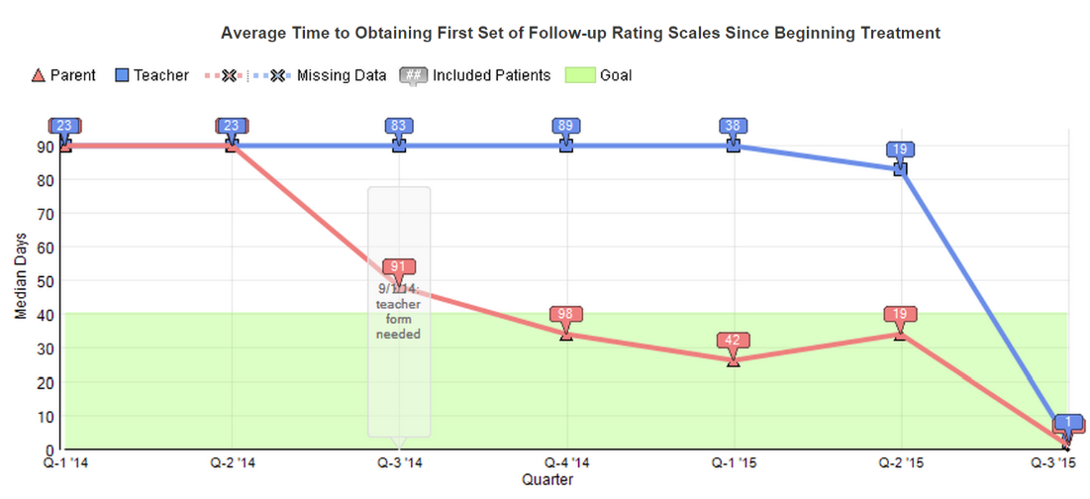

Slide 27
% of patients whose medication initiation is followed up by Vanderbilt Assessment scales from multiple sources within 30 days
Notes:
Track these measures on the monthly reports

Slide 28
CQN ADHD Care Timeline
Assessment Visit
Treatment Visit
Treatment Follow-up
Long-term Follow-up
Use Vanderbilt to assess for ADHD | Have conversation about ADHD diagnosis & provide ADHD brochure
 | Prescribe ADHD medication | Immediately (<2 weeks) assess effectiveness and side effects using ratings | Periodically assess progress using ratings
 | Prescribe Behavior Therapy
Notes:
Patient and family is going to go through these types of visits as they assess and treat appropriately

Slide 29
Medication Maintenance Measure
% of patients whose medication maintenance is properly monitored by multiple sets of Vanderbilt Assessment scales across multiple settings within 180 days of medication initiation.
Goal: 60%
According to NCQA, 45-47% of pediatric ADHD patients receive follow-up care during treatment continuation.
Long-term Follow-up

Slide 30
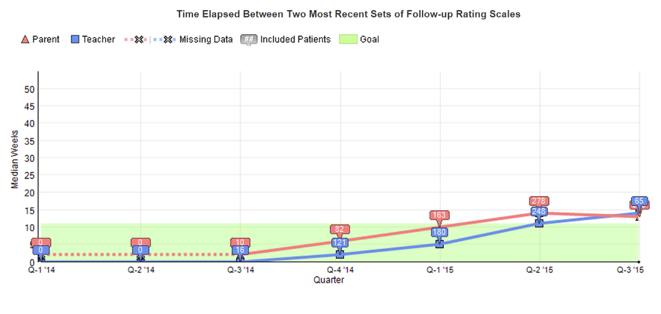

Slide 31
% of patients whose medication maintenance is properly monitored by multiple sets of Vanderbilt Assessment scales across multiple settings within 180 days of medication initiation.
Notes:
Track these measures on the monthly reports. With lag time there will be some time before this measure has much to show.

Slide 32
Chronic Care – Action Statement 4
The primary care clinician should recognize ADHD as a chronic condition and, therefore, consider children and adolescents with ADHD as children and youth with special health care needs. Management of children and youth with special health care needs should follow the principles of the chronic care model and the medical home.
Long-term Follow-up

Slide 33
Outcome – “a health state of a patient resulting from health care.”
Notes:
Measure Type: Outcome Measure
For example, the percentage of patients with a myocardial infarction who receive an aspirin prescription on discharge is a process measure based on strong evidence that aspirin can prevent future cardiovascular events. Process vs outcome.
Process, outcome balancing. All critical for sustainable improvement

Slide 34
TSS Reduction Measure
Average percent reduction in ADHD total Symptom score from initial assessment to most recent follow-up assessment
One measure for parent and one for teacher
Goal: 25% reduction in TSS
Long-term Follow-up

Slide 35
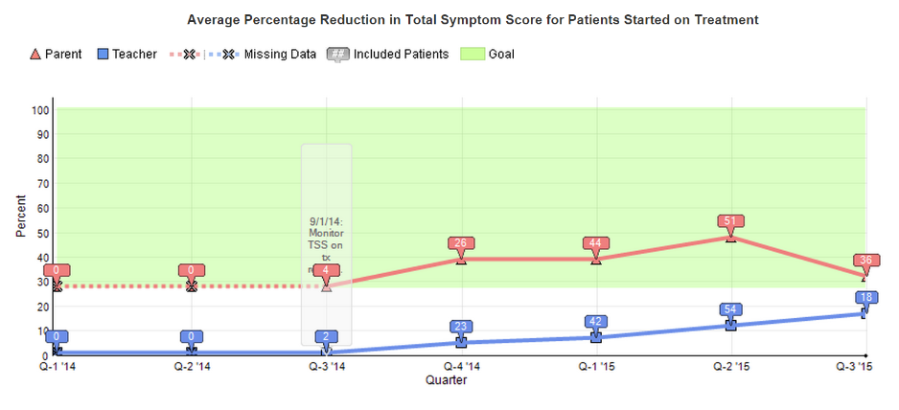

Slide 36
Participation Measure – Patients Registered
Number of patients registered on the mehealth for ADHD portal each month
MOC Criterion: An average of 5 unique patient records in at least 5 of the first 6 months (Phase 1: January – June)
Notes:
MOC requirement

Slide 37
Monitoring Performance
Check Report Card Regularly
After Month 1 Reports Identify Area of Focus
Conduct PDSA on Area of Focus

Slide 38
Portal Demo
Short demo of Test of Change Wizard

Slide 39
Evaluation of ADHD web portal
Does ADHD web portal intervention lead to improved ADHD treatment care?
Does ADHD web portal lead to improved child outcomes?

Slide 40
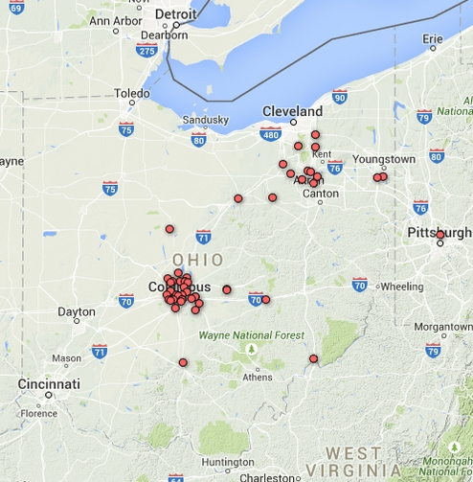
50 Pediatric Practices

Slide 41
Pair practices
% Medicaid
# MDs
RANDOMIZE
Intervention
Control

Slide 42
Intervention vs. Controls
Intervention Group
MD training on evidence-based ADHD care
Guided re-organization of ADHD patient flow
Access to ADHD web portal for 2 years
Guided PDSA at 3- and 6-months
Prompted PDSA at 9- and 12-months
Control Group
Typical ADHD care

Slide 43
ADHD rating scale collection for those treated with medication
 | Control (n=316) | Intervention (n=258) | p-level for diff
Number of parent scales to monitor treatment | .54 scales (.31) | 3.04 scales (.33) | <.0001
Number of teacher scales to monitor treatment in first year | .26 scales (.34) | 2.83 scales (.36) | <.0001

Slide 44
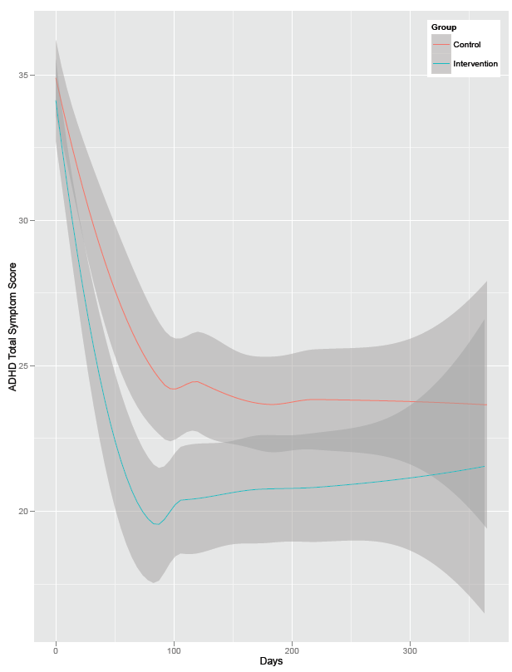
Parent-rated ADHD Symptom Reduction for Children Taking Medication
Control pre-post change: -10.2
Intervention pre-post change: -13.2
Group effect: p<.05
Notes:
data showing decreased symptom burden after using portal

Slide 45
Pediatrician Satisfaction
Overall, my level of satisfaction with the ADHD collaborative is:
 | Frequency
Very dissatisfied | 2
Dissatisfied | 7
Neither satisfied nor dissatisfied | 20
Satisfied | 41
Very satisfied | 19

Slide 46
?

