Slide 1
Welcome to CQN ADHD Learning Session 3
American Academy of Pediatrics
NYS AAP – Chapter 2
July 10, 2016

Slide 2
Commercial Interests Disclosure
Joseph J. Abularrage, MD, MPH, M.Phil, FAAP
Suzanne Emmer
I have no relevant financial relationships with the manufacturer(s) of any commercial product(s) and/or provider of commercial services discussed in this CME activity.
I do not intend to discuss an unapproved or investigative use of a commercial product/device in my presentation.

Slide 3
CQN ADHD Chapter Project Team
Joseph J. Abularrage, MD, MPH, M.Phil, FAAP Physician Lead
Marc Lashley, MD, FAAP
Physician Co-Lead
Jack Levine, MD, FAAP
ADHD Expert
Elie Ward, MSW
Project Manager

Slide 4
CQN ADHD National Leadership Team
Judith C. Dolins, MPH
Principal Investigator
Jeff Epstein, PhD
ADHD Content Advisor
Jennifer Powell, MPH, MBA
Quality Improvement Consultant
James Wiley, MD, FAAP
ADHD Content Advisor
Suzanne Emmer
Director, Division of Chapter QI Initiatives
Ed Wise
Chapter Data Analyst
Allie Stevens, MPH, MS
Project Manager, Chapter Quality Network

Slide 5
CQN ADHD NYS AAP - Chapter 2 Practices
Advanced Pediatrics
Carlos A Ortiz MD PC
Central Nassau Pediatrics
Dr T’s Pediatrics PLLC
Jose Quiwa MD PC
Marjan Y. Tabibzadeh, MD, PLLC
NewYork-Presbyterian/Queens
Park Slope Pediatrics
Pediatric Health Associates
Pediatric Plaza
ProKids
RBK Pediatrics & Urgent Care
SPAB Pediatrics LLC
Valley Stream Pediatrics

Slide 6
How Will We Work Together?
This is your training…
Ask questions
Push back
Learn from one another
The chapter and national teams may not have all of the answers, but we’ll work together to find them

Slide 7
Congratulations! Your Progress to Date:
Become adept at working in teams
Developed systems to regularly monitor mehealth
Regularly reviewed QI data reports and begun basing improvement efforts on these results
Shared with and learned from other practices in your collaborative

Slide 8
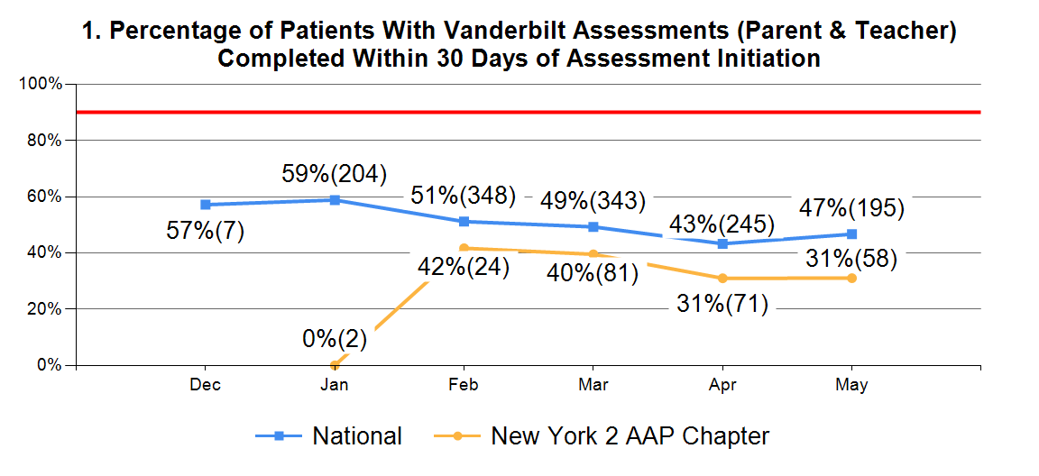
Chapter Leaders: New York 1 (55%)
Your Chapter: 31%
Notes:
May data
This measure doesn’t show the whole picture; the practices may be getting Vanderbilts back, just not within 30 days.

Slide 9
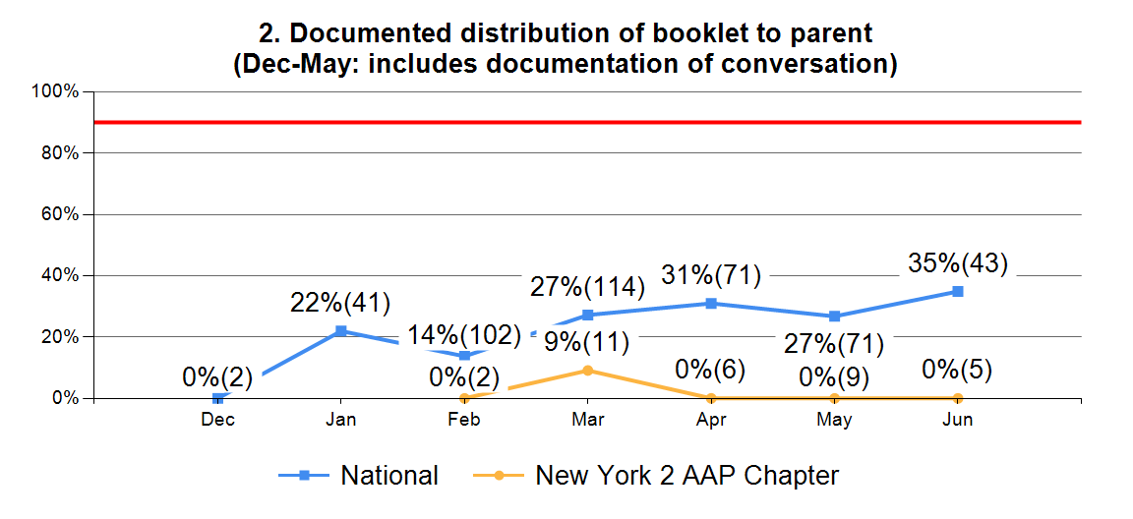
Chapter Leaders: Texas (56%)
Your Chapter: 0% (Small sample size of 5)
Notes:
May data
Many of the practices are doing both of these things; likely a documentation issue. We are removing the conversation component very soon and we will let them know when. Next time you see this measure, we expect that it will be much higher because we’ll only be measuring distribution of the booklet.

Slide 10
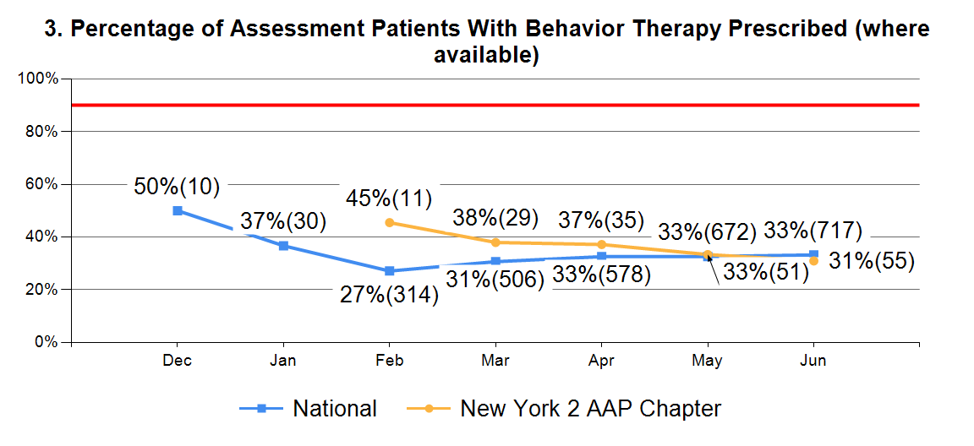
Chapter Leaders: Georgia (40%)
Your Chapter: 31%
Notes:
May data
The sample size and the percentage has slowly been improving since February.
April: about 190 patients had BT prescribed.
May: about 220 patients had BT prescribed.
So, while the rate is steady, about 30 more patients were prescribed BT in May. These are cumulative numbers.

Slide 11
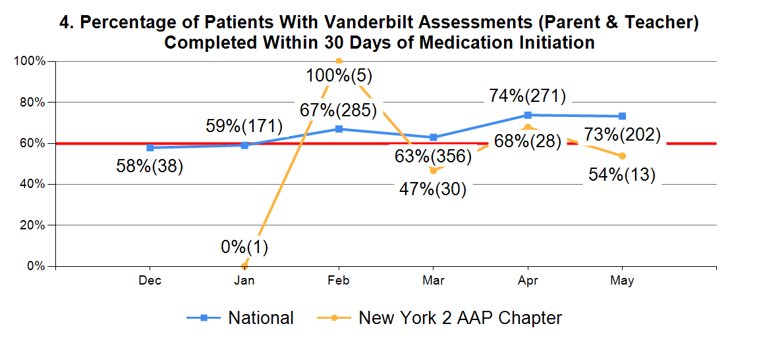
Chapter Leaders: Arkansas (100%)
Your Chapter: 54%
Notes:
May data
We’ve heard some of you hypothesize that this measure is so much higher than VA return during assessment because parents and teachers are quite eager to see how the medication is working for their child. Well over goal, nice consistent progress.

Slide 12
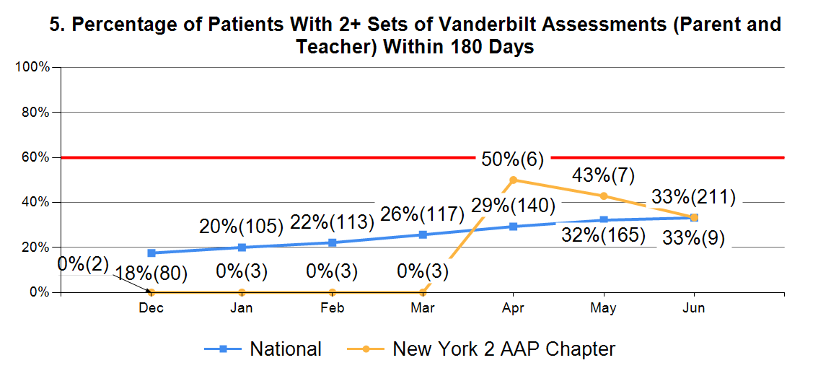
Chapter Leaders: Texas (47%)
Your Chapter: 33%
Notes:
May data
This is also a strong positive trend toward goal and we think we can reach goal in cycle 2, as we’ll be focusing more on follow-up.

Slide 13
So… what’s next?

Slide 14
Institute for Healthcare Improvement Breakthrough Series Collaborative Model Chapter Quality Network ADHD Project (12-month timeframe)
Focus: Standardizing, Delegating and Building Reliable Systems
Focus: Diagnosis & Early Follow-Up
Learning Session 1
January 2016
1-day in-person meeting
Learning Session 2
April 2016
Webinar
Learning Session 3
Summer 2016
1-day in-person meeting
Learning Session 4
November 2016
Webinar
Action Period 1
Action Period 2
Action Period 3
Notes:
We have just completed action period 2 on this diagram and are, as you know, currently in LS3. After this we’ll move into action period 3, where you’ll really begin digging deeper into how you’re going to hardwire these systems into your practices and build a reliable ADHD care system. We will begin planning for that this afternoon.
Source: The Breakthrough Series: IHI’s Collaborative Model for Achieving Breakthrough Improvement. IHI Innovation Series white paper. Boston: Institute for Healthcare Improvement; 2003. Available at: http://www.ihi.org/resources/pages/ihiwhitepapers/thebreakthroughseriesihiscollaborativemodelforachievingbreakthroughimprovement.aspx.

Slide 15
Action Period 3 Focus:
Long-term management of ADHD
Follow-up with parents, teachers and patients
Hardwiring reliable systems
Standardizing processes
Notes:
This is reflected in the MOC requirements for cycle 2: 20 follow-up assessments initiated in the mehealth portal.

Slide 16
Purpose of the Learning Session
Review and identify trends and variation in quality improvement data
Discuss the parent and teen perspective in regards to long-term ADHD management, as well as key messages to communicate during times of transition
Develop a deeper understanding of medication management for children with ADHD + co-morbidities, non-stimulant medication management and practical behavior management tips
Assess distribution of roles and responsibilities to ensure we continue to build and sustain processes that result in improved ADHD care
Determine key activities for action period 3

Slide 17
Agenda
Time | Session Name | Presenter/Facilitator
9:00 – 9:15 am | Welcome and Introductions | Joseph J. Abularrage, MD, MPH, M.Phil, FAAP Suzanne Emmer
9:15 – 10:25 am | Interactive Data Review | Joseph J. Abularrage, MD, MPH, M.Phil, FAAP Jennifer Powell, MPH, MBA
10:25 – 10:40 am | Break
10:40 – 11:25 am | The Parent Perspective: Transitions | Joseph J. Abularrage, MD, MPH, M.Phil, FAAP Emily Diamond Allie Stevens, MPH, MS
11:25 – 12:25 pm | Medication Management: Part 1 | Jack Levine, MD, FAAP

Slide 18
Agenda
Time | Session Name | Presenter/Facilitator
12:25 – 1:15 pm | Lunch
1:15 – 2:00 pm | Medication Management: Part 2 | Jack Levine, MD, FAAP
2:00 – 3:30 pm | Team Meetings | Jennifer Powell, MPH, MBA
3:30 – 3:45 pm | Where Do We Go From Here? | Joseph J. Abularrage, MD, MPH, M.Phil, FAAP Jennifer Powell, MPH, MBA Elie Ward, MSW

Slide 19
Reminders
Appropriately manage electronic devices
Approach material with an open mind
Seek out practical application
Share your ideas and concerns
Honor the time commitment for the session
Relax, be yourself, and have fun!

